Slide 1

Team 5 : Bugs Bunny
Less is More!
Feed Amalgamator

Slide 2
Team 5 : Bugs Bunny
Bug Driven Development!
Feed Amalgamator

Slide 3
Table of Content
Project Outline
Process
Architecture
Flow Diagram
Systems
CI CD Flow
Azure Deployment
Google Analytics
Monitoring
Lessons Learnt

Slide 4
Project Outline:
Bugs Bunny cannot change the Federated nature of the Fediverse, and the need to create several accounts to follow feeds from unfederated servers .
But we can try to make interacting with several accounts easier!
Feed Amalgamator
Our product:
An application that amalgamates feeds from different Mastodon accounts on different servers.
Features:
Create account with amalgamator.
Add / Delete Mastodon account feed to amalgamator.
View amalgamated feed.

Slide 5
Table of Content
Project Outline
Process
Architecture
Flow Diagram
Systems
CI CD Flow
Azure Deployment
Google Analytics
Monitoring
Lessons Learnt

Slide 6
Process
Kanban approach → Decision in adherence with overall team experience level
Scrum element → Meetings bi-weekly on a regular basis
Visualization of work items in Kanban Board
Kanban Board → Central Tool to visualize work and workflows
Work items → represented as cards in the Kanban Board
Benefits of Kanban
Flexibility in planning
Shorter cycle times for tasks
Fewer bottlenecks in process
Use of visual metrics for continuous improvement
https://github.com/orgs/CSE210-Team-5/projects/1/views/1

Slide 7
Table of Content
Project Outline
Process
Architecture
Flow Diagram
Systems
CI CD Flow
Azure Deployment
Google Analytics
Monitoring
Lessons Learnt

Slide 8
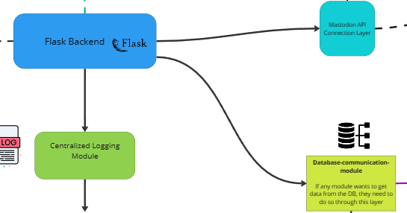
Architecture
Each module has a clearly defined role (separation of concerns)

Slide 9
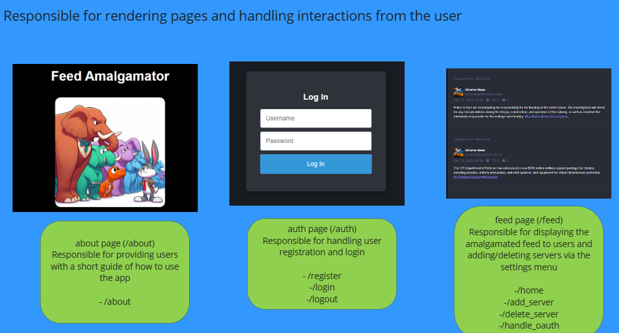
Architecture
Site is split into 3 main pages:

Slide 10
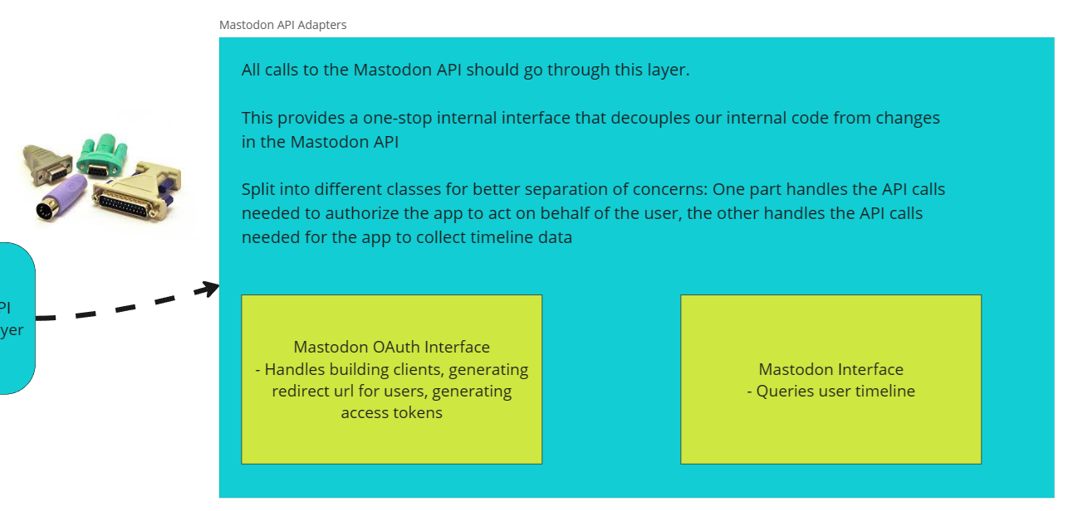
Architecture
Interfaces such as the database later and the Mastodon API layer make the application more modular

Slide 11
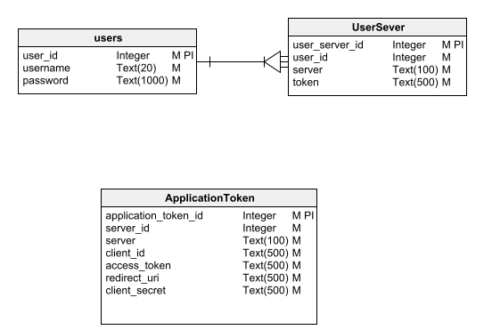
Architecture - ER Diagram

Slide 12
Table of Content
Project Outline
Process
Architecture
Flow Diagram
Systems
CI CD Flow
Azure Deployment
Google Analytics
Monitoring
Lessons Learnt

Slide 13
Flow Diagram

Slide 14
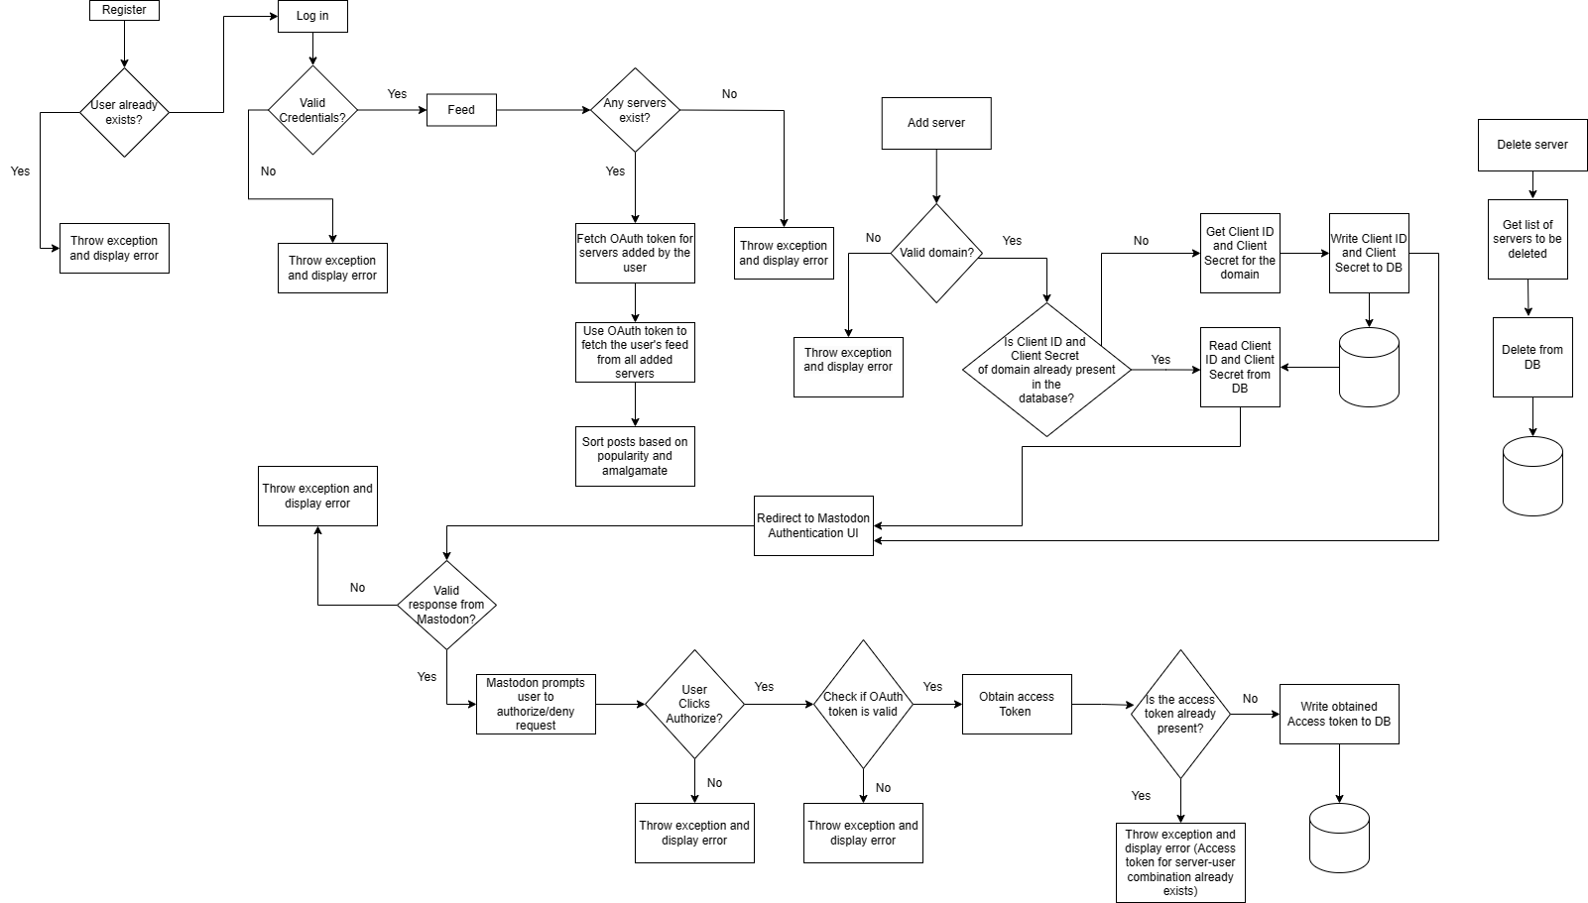

Slide 15
Table of Content
Project Outline
Process
Architecture
Flow Diagram
Systems
CI CD Flow
Azure Deployment
Google Analytics
Monitoring
Lessons Learnt

Slide 16
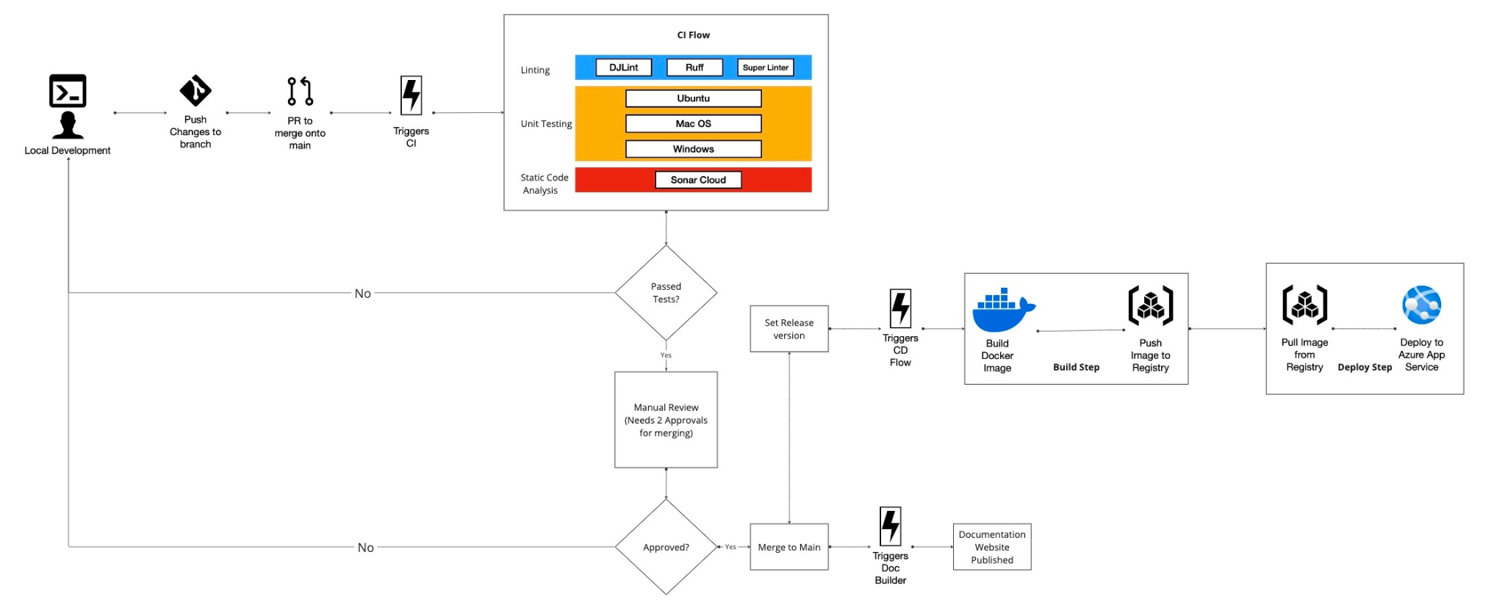
Systems - CI / CD Flow
Miro Board
Sonar cloud

Slide 17

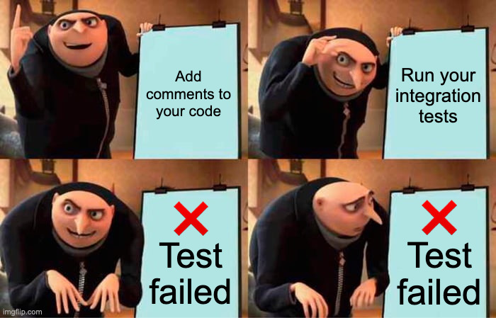
Run Linting

Slide 18
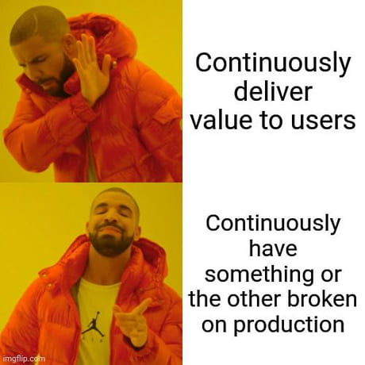
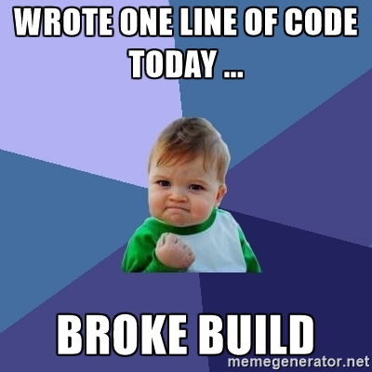

Slide 19
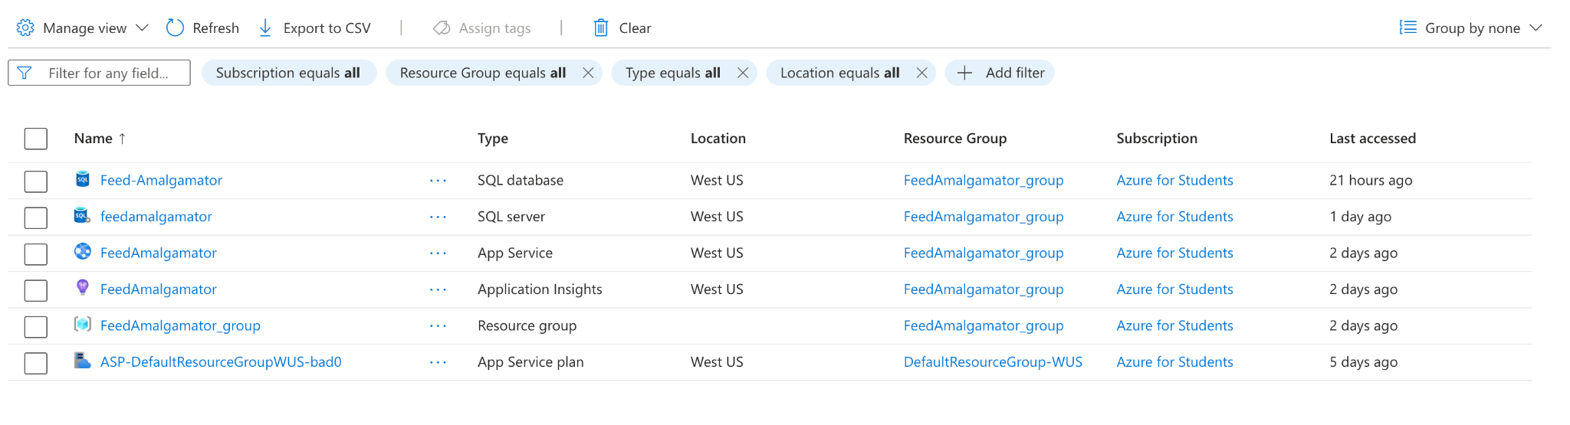
Systems - Azure Deployment
Github Repo
Azure Dashboard

Slide 20
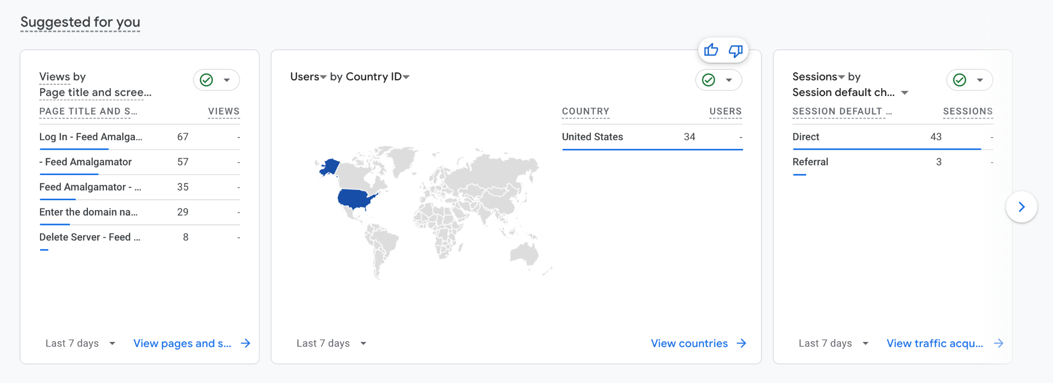
Systems - Google Analytics page
Google Analytics Dashboard

Slide 21
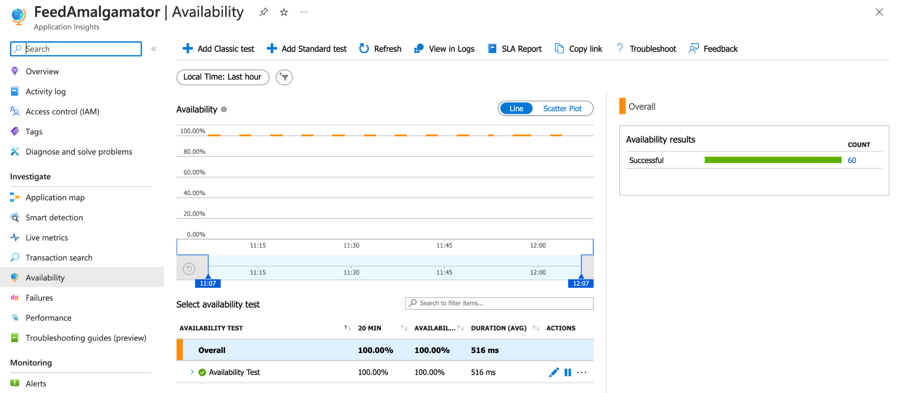
Systems - Monitoring Page
Dashboard

Slide 22
Table of Content
Project Outline
Process
Architecture
Flow Diagram
Systems
CI CD Flow
Azure Deployment
Google Analytics
Monitoring
Lessons Learnt

Slide 23
Lessons Learnt

Slide 24

Discovered that writing clean code is like leaving a clean kitchen after cooking – nobody notices until it's a disaster, and suddenly everyone's pointing fingers.

Slide 25

Realized that CI/CD is the unsung hero of software development, like the guy who changes the toilet paper roll at the office

Slide 26

Logging and exception handling were as challenging as convincing a cat to take a bath – you think you have control, but then things get unexpectedly messy, and you're left questioning your life choices.

Slide 27
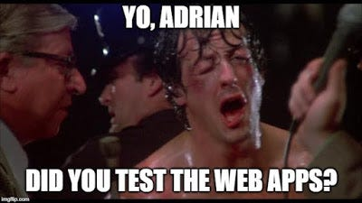
Explored more ways to test a full-stack web app than google maps navigating through UCSD.

Slide 28

Software engineering is like throwing a surprise party for introverts – you spend more time trying to get people to collaborate than you do fixing that unclosed HTML tag.

Slide 29
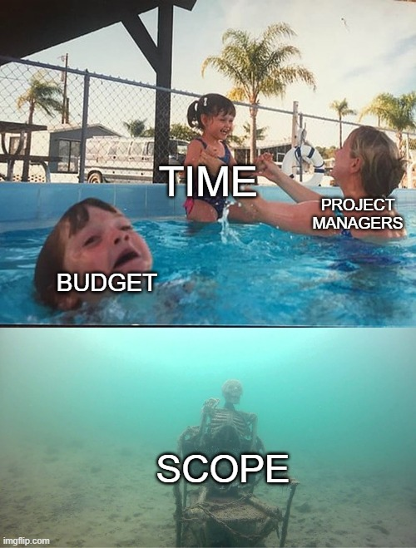
Scoping is like trying to assemble IKEA furniture without the instructions – you might end up with a wonky bookshelf instead of a sleek project

Slide 30
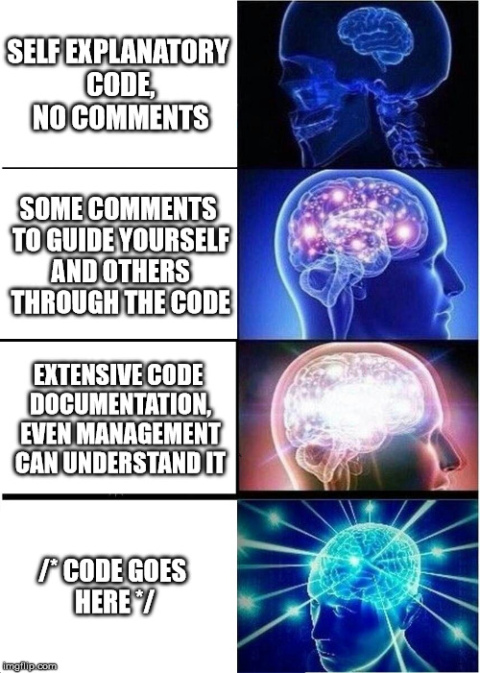
DOCUMENT EVERY GODDAMN THING!!!! - Reading undocumented code is like watching Inception backwards.

Slide 31

Table of Content
Project Outline
Process
Architecture
Flow Diagram
Systems
CI CD Flow
Azure Deployment
Google Analytics
Monitoring
Lessons Learnt

Slide 32
Thank you!

